Slide 1
ARS Workbook(Final)
File created on: 6/11/2026 12:41:34 AM

Slide 2
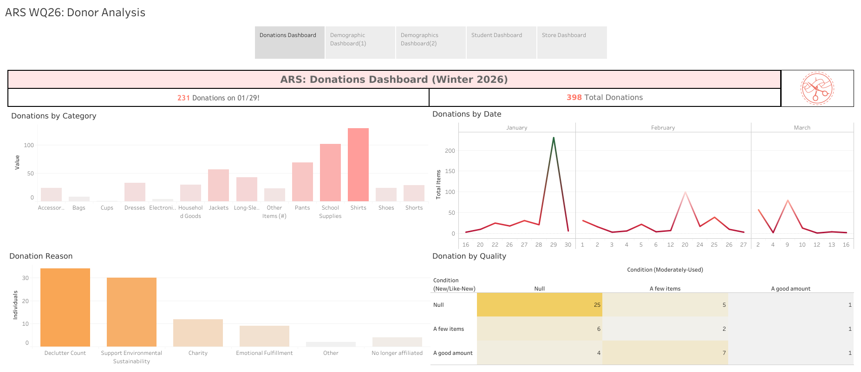

Slide 3
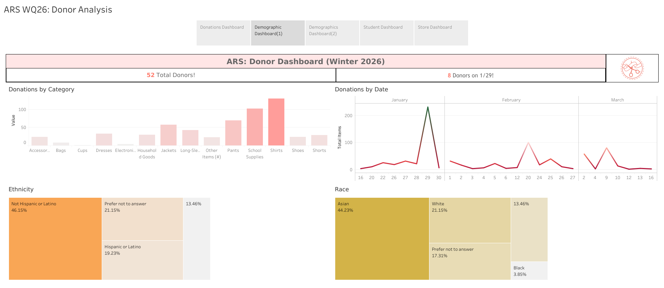

Slide 4
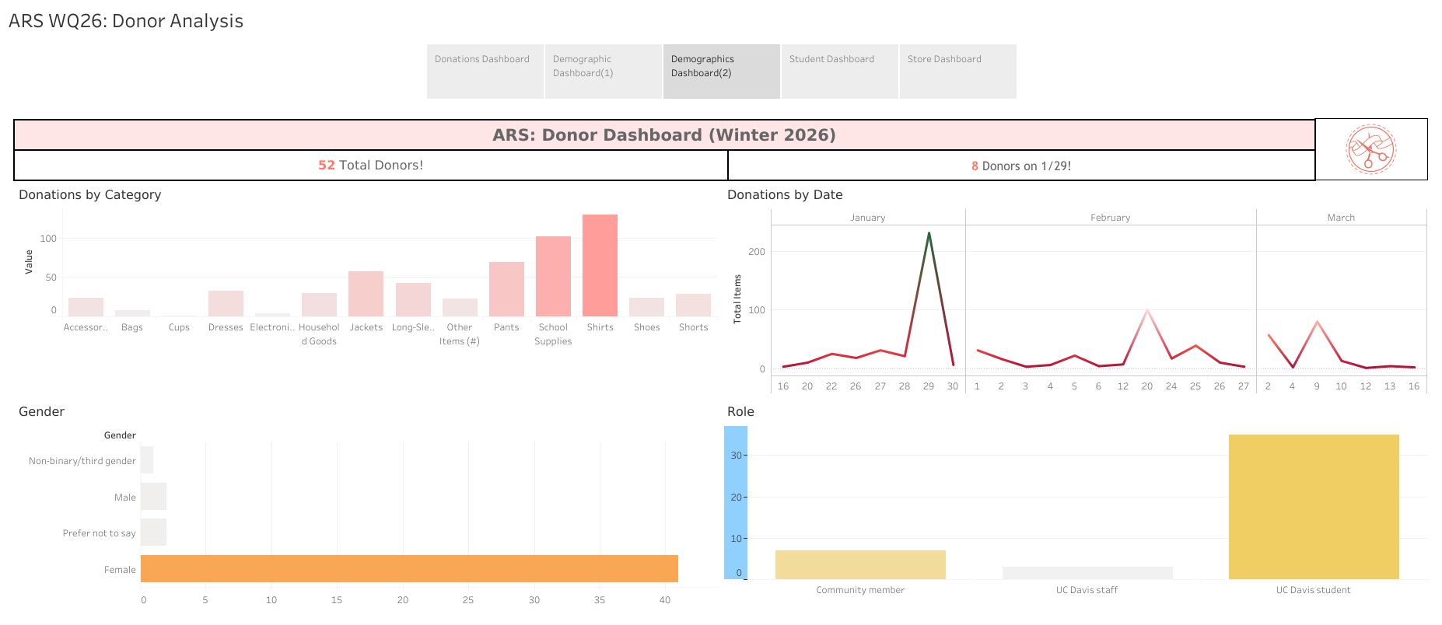

Slide 5
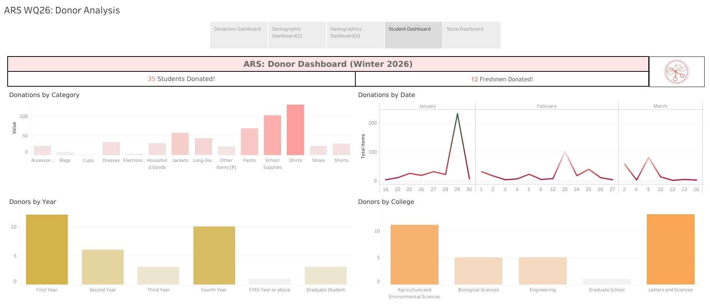

Slide 6
